Slide 1
R3 CORDA ARCHITECTURE
161070001 - Vineet Rao
161070004 - Vinayak Borhade
161070015 - Ameya Daddikar

Slide 2
DISTRIBUTED LEDGER
A distributed ledger is a consensus of replicated, shared, and synchronized digital data.
Make data spread over a large number of devices commonly agreed
May be distributed across domains, institutions, geographies
Traditional ledgers for finance
New ledger technologies only a digitization
Distributed ledger utilizes networks and distributed storage for better transperancy

Slide 3
IMPLEMENTATION
Underlying technology usually blockchain
Considers blocks of transactions in a time series to form back-linked list
Uses cryptography to ensure consensus
Disadvantage:
Public transactions
Long consensus time

Slide 4
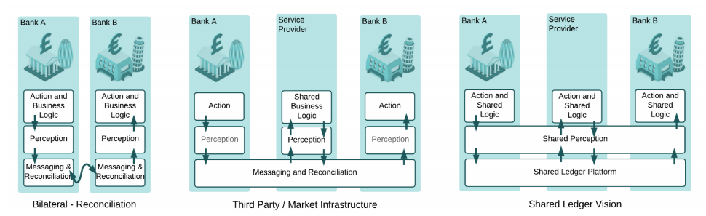
FINANCIAL RECONCILIATION

Slide 5
MAIN SERVICES
AND FEATURES
CONSENSUS - Between parties, not all
VALIDITY - Per transaction basis
UNIQUENESS - Different tradeoffs, CAP
IMMUTABILITY - Validated data cannot be erased
AUTHENTICATION - On party basis, without admin account
Nodes are in authenticated P2P network
No gossip protocol
Define tx with JVM bytecode
Parallel tx on nodes with no knowledge of other tx
Notary consensus
Need-to-know sharing
Scheduled events

Slide 6
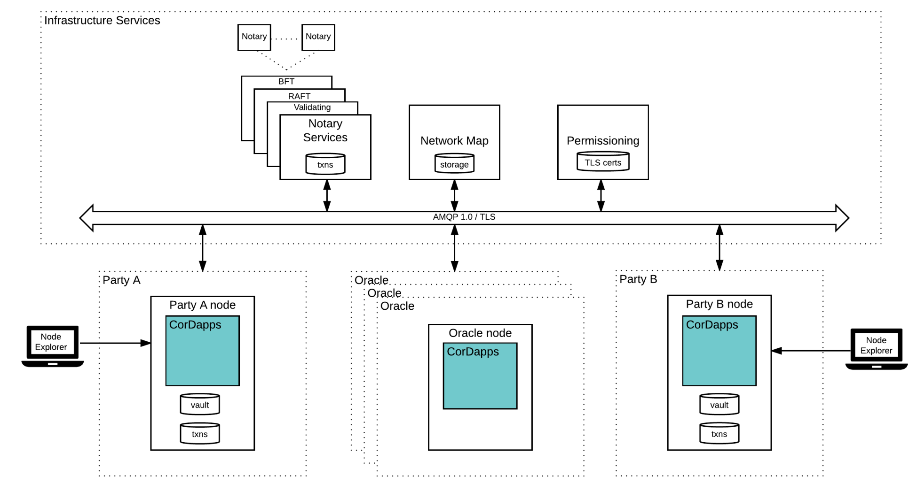
ARCHITECTURE

Slide 7
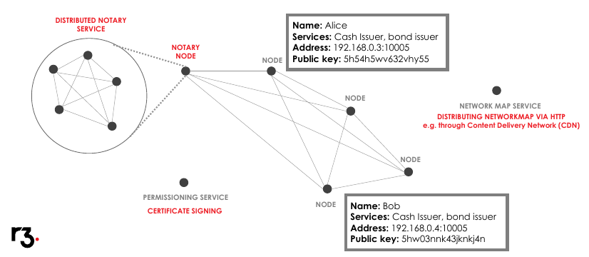
NETWORK ARCHITECTURE OVERVIEW

Slide 8
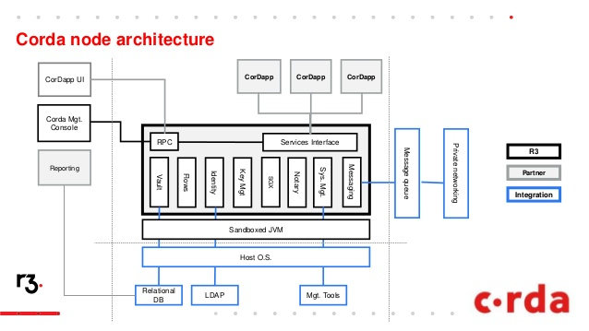
NODE ARCHITECTURE

Slide 9
MAJOR COMPONENTS
State objects:
Represent agreement
Contain code
Reference legal prose
Transactions:
Transition states
Lifecycle where input states become historic
Pure functions
Flow framework:
Coordination control
Notary services:
Analogous to miners
Multiple notary nodes of different types
Validate transactions
Oracles:
Authority to attest to off-ledger facts
External data source

Slide 10
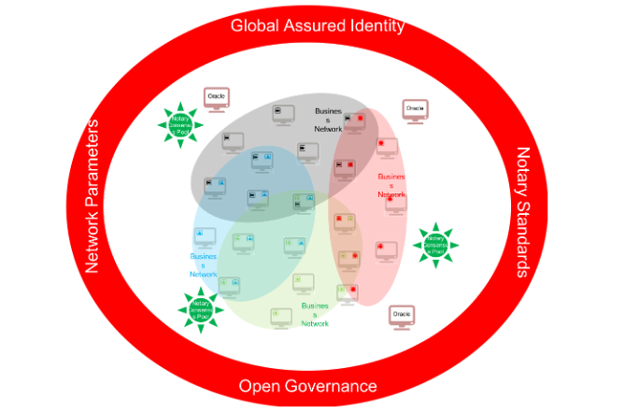
GLOBAL CORDA NETWORK
Network parameters
Identity framework
Consensus pools
Oracles
Fiat currencies and native digital tokens
Open governance

Slide 11
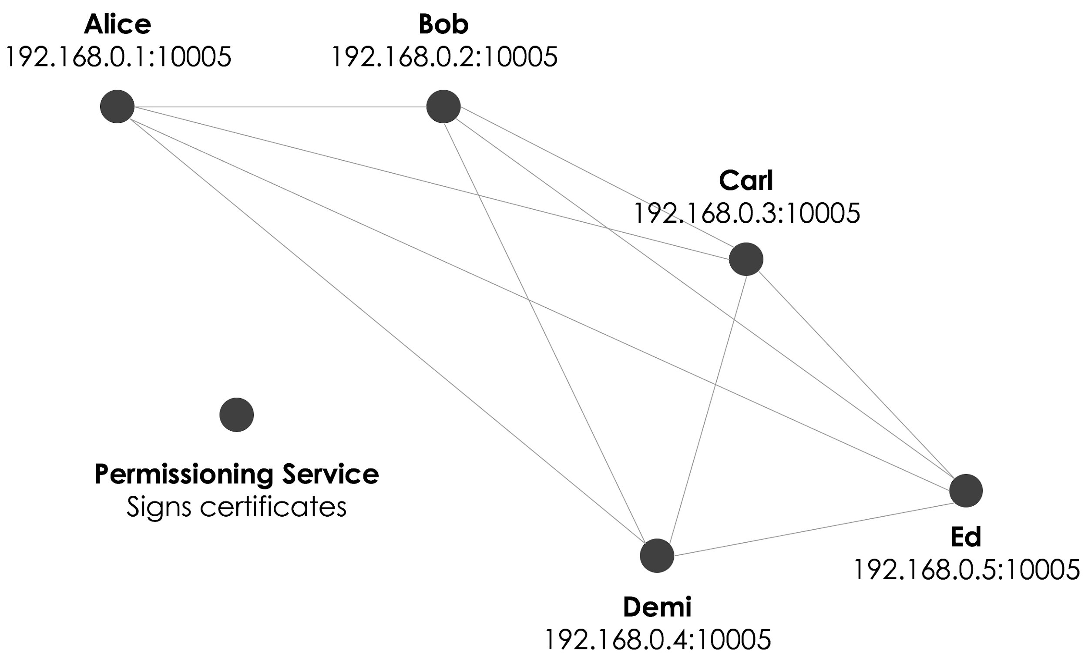
Key Concepts - Network
Nodes running Corda and CorDapps
Point-to-point Communication
Certificate for network identity - Real world Identity
Permissioned Network
P2P Network - TLS Encryption
Identity - Network map service IP
IP addresses - messaging
Confidential identities for individual transactions
Admission - semi private network

Slide 12
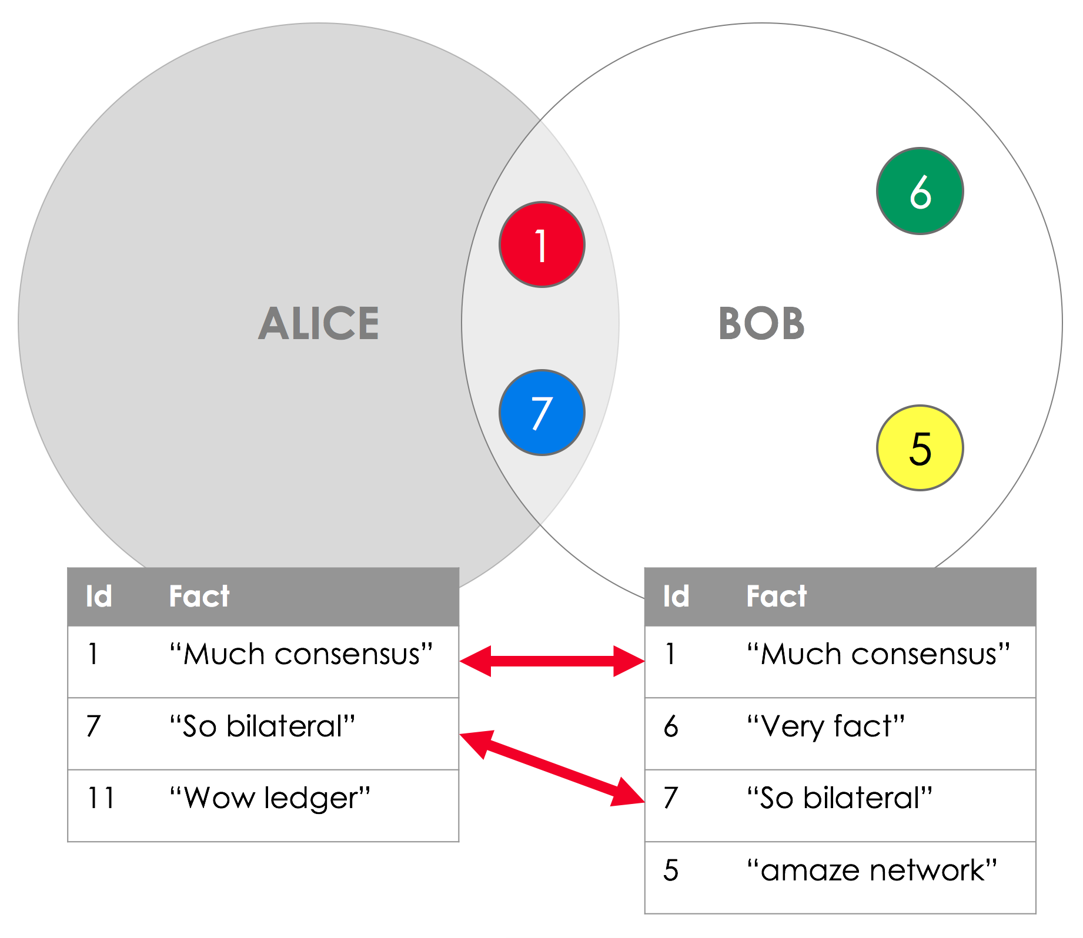
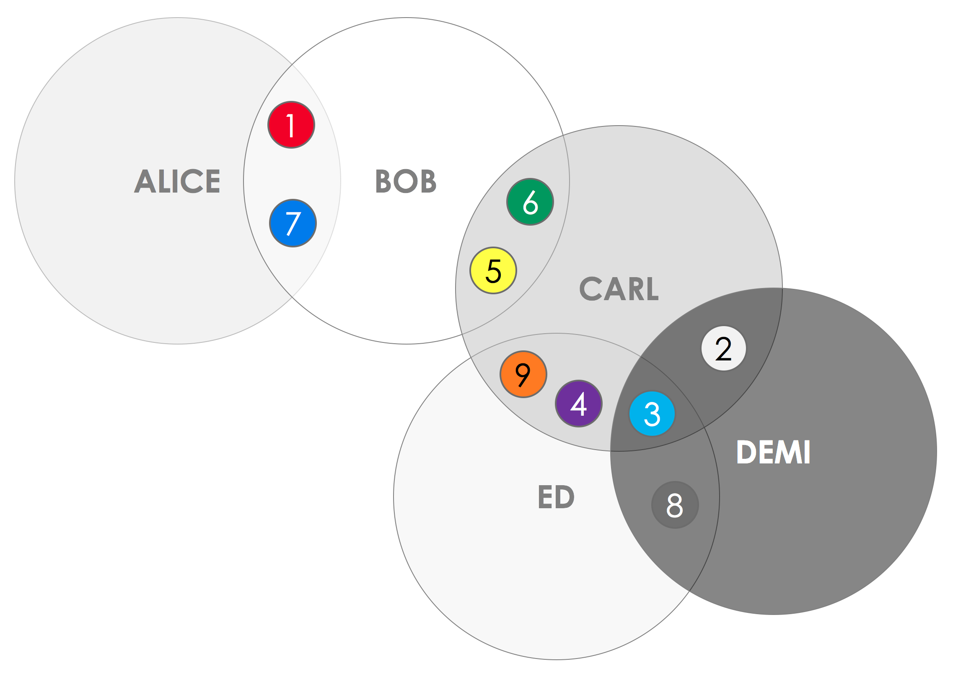
Key Concepts - Ledger
Subjective
No single central data store - separate database - facts subset
Fact sharing - Lockstep in the database

Slide 13
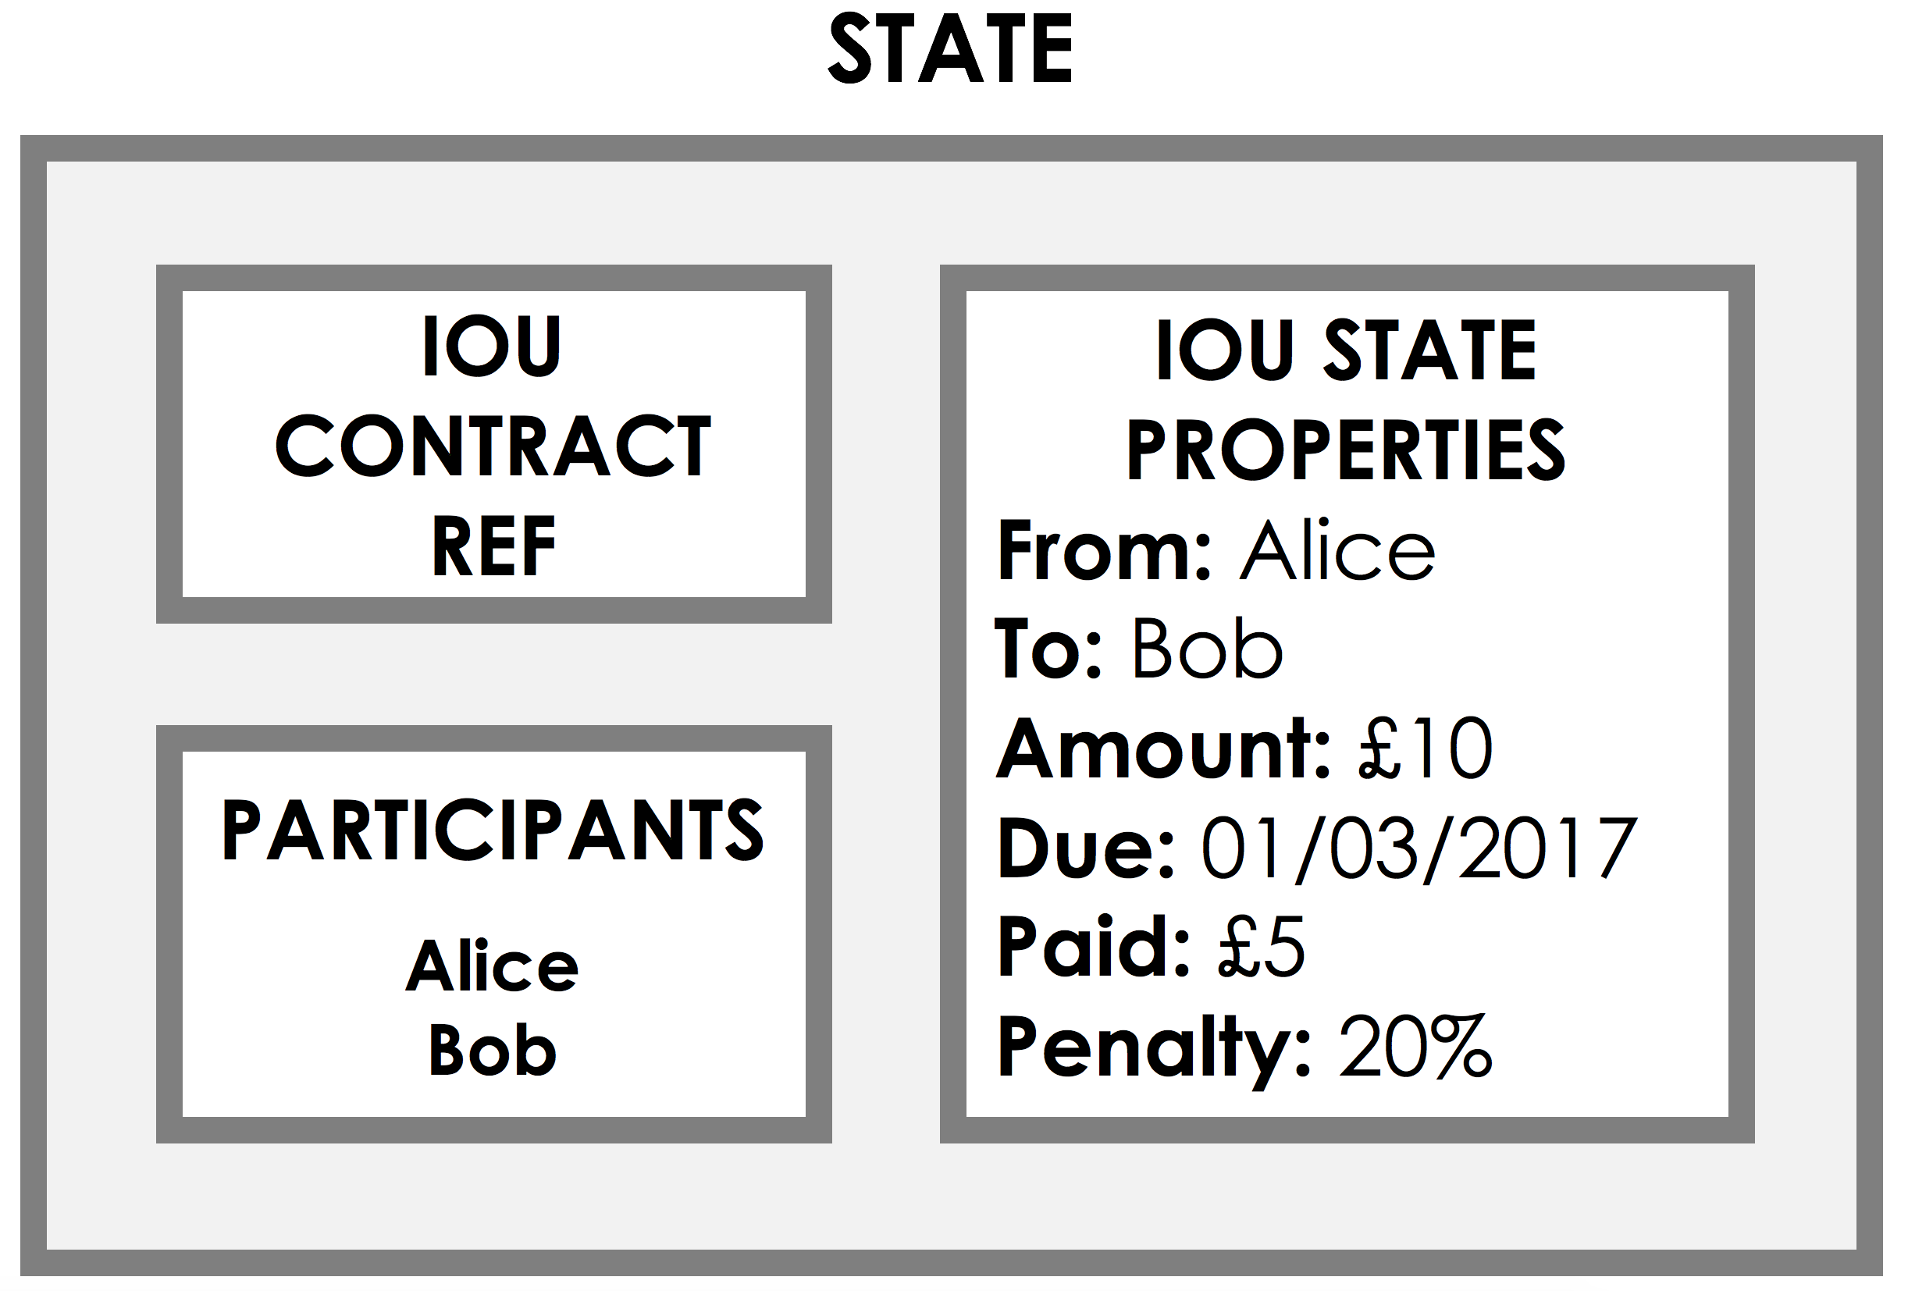
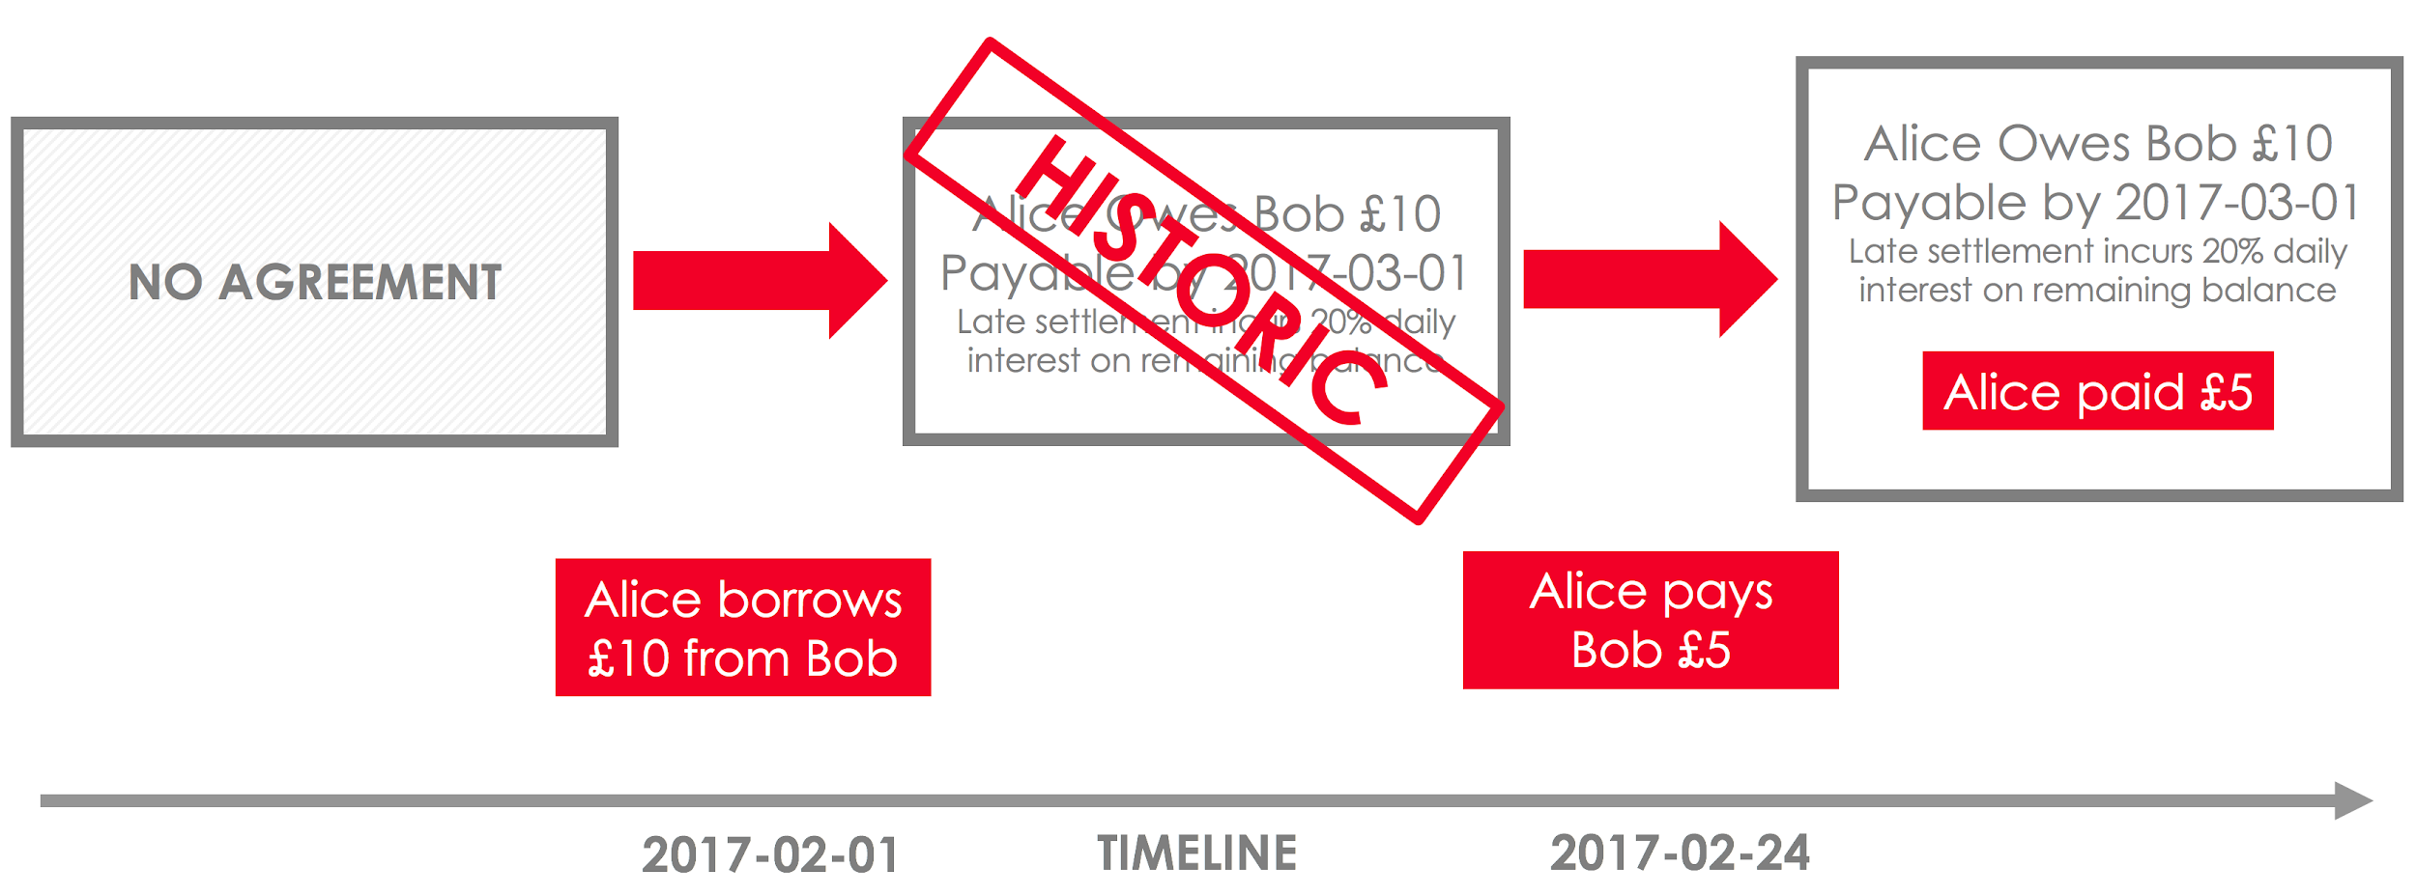
Key Concepts - States
On-Ledger facts details
Immutable object - fact known by Corda nodes
Facts - stocks, bonds, loans, KYC data …
State Sequences - lifecycle of a shared fact
New version of every state | Historic
Vault - tracks the States
Current states - View point

Slide 14
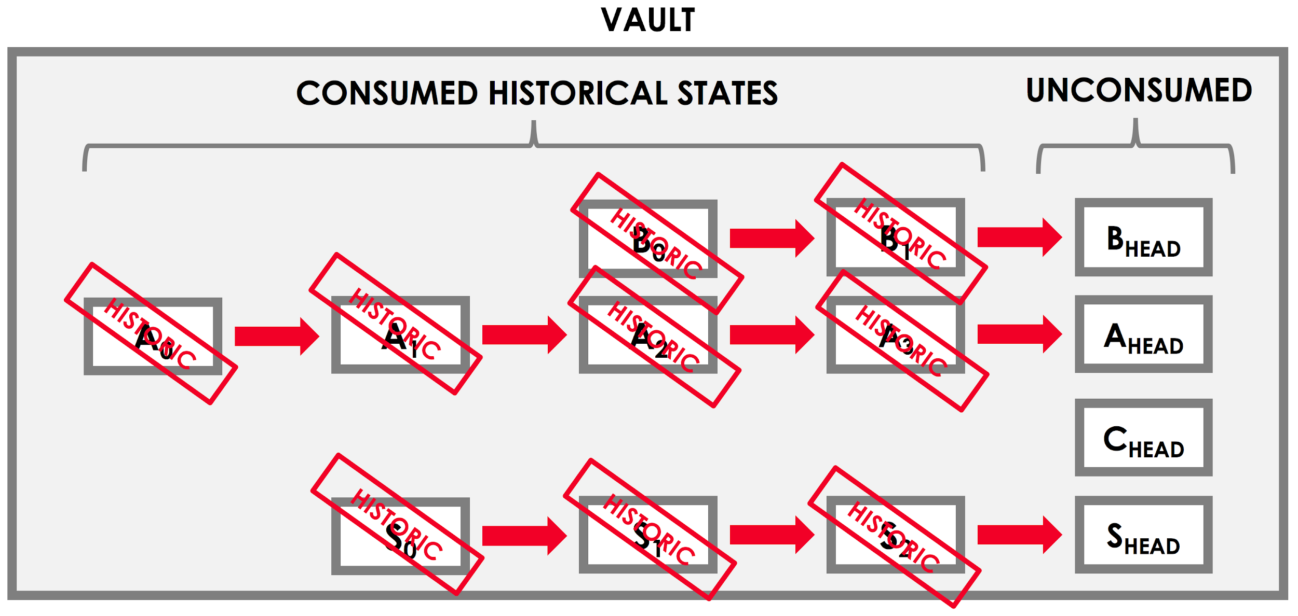
Key Concepts - States

Slide 15
Key Concepts - Contracts
UTXO (Unspent Transaction Output) Model
inputs, outputs and references
state types (e.g. both cash and bonds)
merge or split fungible assets (e.g. combining a $2 state and a $5 state into a $7 cash state)
atomic: either all the transaction’s proposed changes are accepted, or none
When creating a new transaction, the output states that the transaction will propose do not exist yet, and must therefore be created by the proposer(s) of the transaction. However, the input states already exist as the outputs of previous transactions. We therefore include them in the proposed transaction by reference.
Input’s index in the outputs of the previous transaction
Transactions initially - update proposals - Signatures -> committed

Slide 16
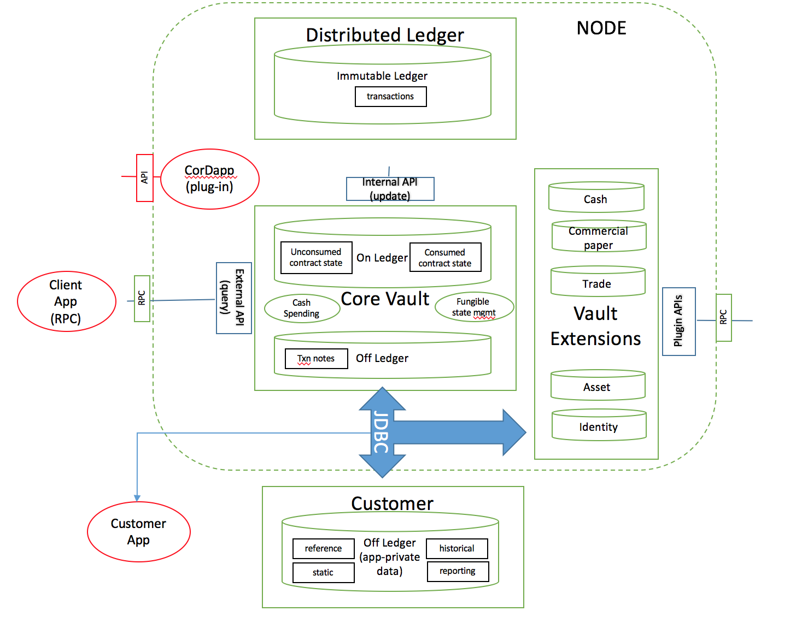
CORDA VAULT

Slide 17
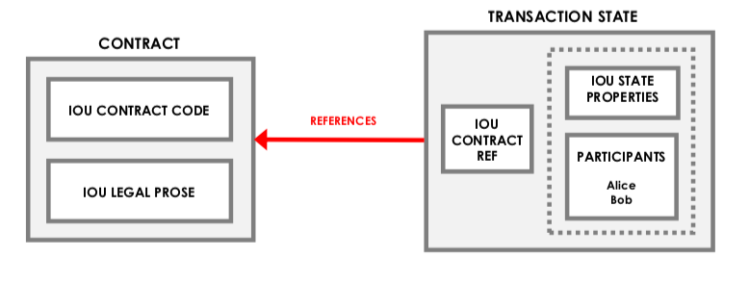
Contracts
Corda mandates that each state inside a transaction must reference a contract

Slide 18
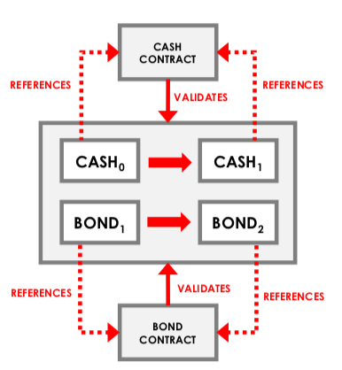
As transactions may contain multiple state types, multiple contracts can be referenced in a transaction
The Corda platform will use all referenced contract code to verify a (proposed) transaction
The contract code is a “pure” function executed in a deterministic environment, on a need-to-know basis which verifies transactions

Slide 19

Contracts
The contract code is a “pure” function executed in a deterministic environment, on a need-to-know basis which verifies transactions.
The verification function is defined in the contract code.
The function takes a transaction as a parameter and either throws an exception if the transaction fails verification, or returns nothing if the transaction verifies.

Slide 20
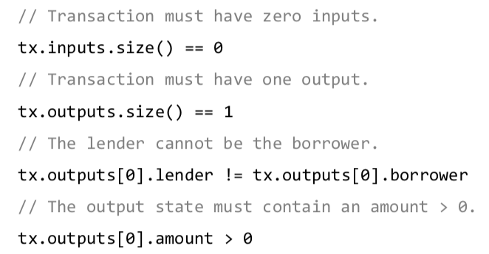
The contract code can be written in any JVM language, and has access to the full capabilities of the language, including:
Checking the number of inputs, outputs, commands, time-window, and/or attachments
Checking the contents of any of these components
Looping constructs, variable assignment, function calls, helper methods, etc.
Grouping similar states to validate them as a group (e.g. imposing a rule on the combined value of all the cash states)
Example code for verification function

Slide 21
Consensus
Uniqueness Consensus
Validity Consensus

Slide 22
Uniqueness Consensus
Uniqueness consensus is the requirement that none of the inputs to a proposed transaction have already been consumed in another transaction.
Used to avoid double spending
If one or more of the inputs have already been consumed in another transaction, this is known as a double spend, and the transaction proposal is considered invalid.
Uniqueness consensus is provided by notaries.

Slide 23
Notary Services
A notary cluster is a network service that provides uniqueness consensus by attesting that, for a given transaction, it has not already signed other transactions that consumes any of the input states of the proposed transaction.
Notary clusters prevent “double-spends”
Notary clusters are also time-stamping authorities. If a transaction includes a time-window, it can only be notarised during that window
Notary clusters may optionally also validate transactions, in which case they are called “validating” notaries, as opposed to “non-validating”
A network can have several notary clusters, each running a different consensus algorithm

Slide 24
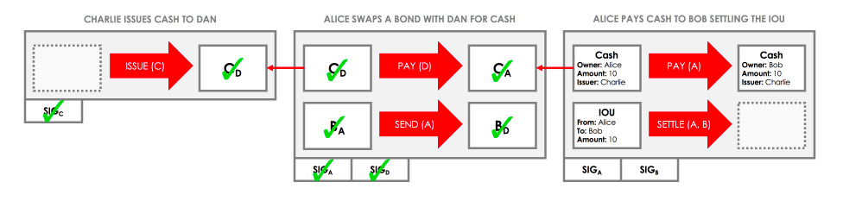
Validity Consensus
Validity consensus is the process of checking that the following conditions hold both for the proposed transaction, and for every transaction in the transaction chain that generated the inputs to the proposed transaction: 1. The transaction is accepted by the contracts of every input and output state
2. The transaction has all the required signatures
We must also verify every transaction in the chain of transactions that led up to the creation of the inputs to the proposed transaction. Also called Walking the Chain.

Slide 25
Flows
Flows are light weight processes used to coordinate the complex multi-step, multi- peer interactions required for peers to reach consensus about shared facts
Flows automate the process of agreeing ledger updates
Communication between nodes only occurs in the context of these flows, and is point-to-point
Built-in flows are provided to automate common tasks

Slide 26
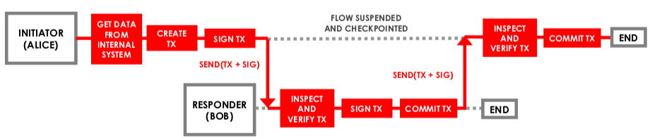
Example of a Two Party Flow interaction

Slide 27
Oracle
Sometimes, a transaction’s contractual validity depends on some external piece of data, such as the current exchange rate
Oracles are network services that, upon request, provide commands that encapsulate a specific fact (e.g. the exchange rate at time x) and list the oracle as a required signer.
If a node wishes to use a given fact in a transaction, they request a command asserting this fact from the oracle.
If the oracle considers the fact to be true, they send back the required command. The node then includes the command in their transaction, and the oracle will sign the transaction to assert that the fact is true.
For privacy purposes, the oracle does not require to have access on every part of the transaction

Slide 28
REFERENCES
https://www.r3.com/wp-content/uploads/2019/08/corda-technical-whitepaper-August-29-2019.pdf
Corda Technical whitepaper, Aug 2019
https://www.r3.com/wp-content/uploads/2019/06/corda-platform-whitepaper.pdf
Corda platform whitepaper, June 2019
https://gendal.me/2016/04/05/introducing-r3-corda-a-distributed-ledger-designed-for-financial-services/
https://docs.corda.net/
Jay Bothra’s lecture on Introduction to Corda

